Slide 1


Korea Hackathon
Alpha Research Automation Framework
Team A
Junhyeok Ahn | Youngjune Kim
Jihwan Byeon | Chanhyeok Park

Slide 2

Contents
1. Main Aspects
2. Alpha Framework
3. Framework Demonstration
Alpha Research Automation Framework
Team A

Slide 3
Main Aspects
1. Equally committed to each of 4 stages of the alpha development process
2. User-friendly, User-driven Framework
3. Use of Random Tree function, Similarity function
4. Application of various neutralizations in the signal Operation Stage
5. Ability to select Alphas to submit based on various criteria
Alpha Research Automation Framework
Team A

Slide 4
Main Aspects
1. Equally committed to each of 4 stages of the alpha development process
- Data processing
- Signal creation
- Signal operation
- Alpha selection
Alpha Research Automation Framework
Team A

Slide 5
Main Aspects
2. User-friendly, User-driven Framework
- Users can search datasets that include specific keywords
- The entire stages of alpha development are not automatically determined but are based on user input
- The meanings of the codes are explained in the comments
- NaN values are automatically handled according to data coverage
Alpha Research Automation Framework
Team A

Slide 6
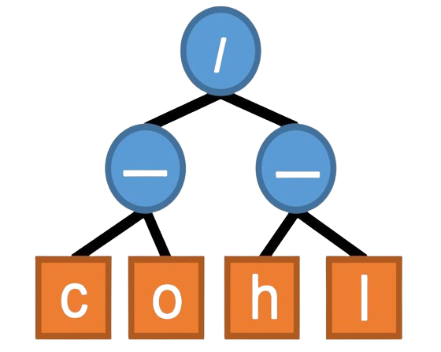
Main Aspects
3. Use of Random Tree function, Similarity function
- Applying the tree structure from the ‘AutoAlpha’ paper to create diverse signals
- Max depth and Max operator counts can be customized
- Calculate the similarity between each tree’s structure and the node values
- Users can get various raw alpha signals
Source: Zhang, T., Li, Y., Jin, Y., & Li, J. (2020, April 4). AutoAlpha: An efficient hierarchical evolutionary algorithm for mining alpha factors in Quantitative Investment. arXiv.org. https://arxiv.org/abs/2002.08245
Alpha Research Automation Framework
Team A

Slide 7
Main Aspects
4. Application of various neutralizations in the signal Operation Stage
- Apply all Neutralizations within the BRAIN setting
- Create custom groups to enable neutralization from new perspectives
e.g.) Use of bucket() and densify(), Group type datasets(pv13)
Alpha Research Automation Framework
Team A

Slide 8
Main Aspects
5. Ability to select Alphas to submit based on various criteria
- Consider Self Correlation, Prod Correlation
- Fitness, Sharpe, Turnover, etc.
- Test_Sharpe / Train_Sharpe Ratio: → To check if the Alpha still works well recently
Alpha Research Automation Framework
Team A

Slide 9
Alpha Framework
Alpha Research Automation Framework
Team A

Slide 10
Alpha Framework
Data Processing
Signal Creation
Signal Operation
Alpha Selection
Alpha Research Automation Framework
Team A

Slide 11
Alpha Framework
- Select the desired Region, Universe, Delay
- Enter keywords you want to include in the dataset description
- Sort by the desired criterion (Default: Coverage)
- Select Vector type datafields
(For Matrix type, enter separately in the operands list below)
- Create variables: v_open, v_close, v_high, v_low, v_avg
- Operators: simple (+, -, *, /), time series (ts_delay)
- Set days, Max depth and operators of tree structure
- Generate random trees, create expressions
- Calculate similarity between trees to only include unique signals
- Perform operations like rank(), ts_rank(), and rank(ts_rank())
- Simulate a list of Alphas with the default settings
Data Processing
Signal Creation
Signal Operation
Alpha Selection
Alpha Research Automation Framework
Team A

Slide 12
Alpha Framework
- Select the desired Region, Universe, Delay
- Enter keywords you want to include in the dataset description
- Sort by the desired criterion (Default: Coverage)
- Select Vector type datafields
(For Matrix type, enter separately in the operands list below)
- Create variables: v_open, v_close, v_high, v_low, v_avg
- Operators: simple (+, -, *, /), time series (ts_delay)
- Set days, Max depth and operators of tree structure
- Generate random trees, create expressions
- Calculate similarity between trees to only include unique signals
- Perform operations like rank(), ts_rank(), and rank(ts_rank())
- Simulate a list of Alphas with the default settings
- Custom group neutralization (cap, pv_sector, cap & pv_sector)
- Iteration of group operators
(group_neutralize, rank, z_score, scale, normalize)
- Use trade_when() if turnover > 0.3 (condition can be customized)
- Neutralization using the BRAIN setting
- Obtain the final list of prospective Alphas
Data Processing
Signal Creation
Signal Operation
Alpha Selection
Alpha Research Automation Framework
Team A

Slide 13
Alpha Framework
- Operators: simple (+, -, *, /), time series (ts_delay)
- Set days, Max depth and operators of tree structure
- Generate random trees, create expressions
- Calculate similarity between trees to only include unique signals
- Perform operations like rank(), ts_rank(), and rank(ts_rank())
- Simulate a list of Alphas with the default settings
- Custom group neutralization (cap, pv_sector, cap & pv_sector)
- Iteration of group operators
(group_neutralize, rank, z_score, scale, normalize)
- Use trade_when() if turnover > 0.3 (condition can be customized)
- Neutralization using the BRAIN setting
- Obtain the final list of prospective Alphas
- Calculate Self Correlation of each Alpha in the final list
- Select one Alpha from the final list considering various criteria
(Default: Fitness)
- Visualize PnL Chart and check for In-Sample testing status
- Set training and test period and calc. test to train Sharpe ratio
- Check for Prod Correlation and submit Alpha
Signal Creation
Signal Operation
Alpha Selection
Alpha Research Automation Framework
Team A

Slide 14
Alpha Framework
- Custom group neutralization (cap, pv_sector, cap & pv_sector)
- Iteration of group operators
(group_neutralize, rank, z_score, scale, normalize)
- Use trade_when() if turnover > 0.3 (condition can be customized)
- Neutralization using the BRAIN setting
- Obtain the final list of prospective Alphas
- Calculate Self Correlation of each Alpha in the final list
- Select one Alpha from the final list considering various criteria
(Default: Fitness)
- Visualize PnL Chart and check for In-Sample testing status
- Set training and test period and calc. test to train Sharpe ratio
- Check for Prod Correlation and submit Alpha
Signal Operation
Alpha Selection
Alpha Research Automation Framework
Team A

Slide 15
- Calculate Self Correlation of each Alpha in the final list
- Select one Alpha from the final list considering various criteria
(Default: Fitness)
- Visualize PnL Chart and check for In-Sample testing status
- Set training and test period and calc. test to train Sharpe ratio
- Check for Prod Correlation and submit Alpha
Framework Demonstration
Alpha Selection
Alpha Research Automation Framework
Team A

Slide 16
Thank You
Alpha Research Automation Framework
Team A

